Slide 1

ANDROID QUIZ APP

Slide 2
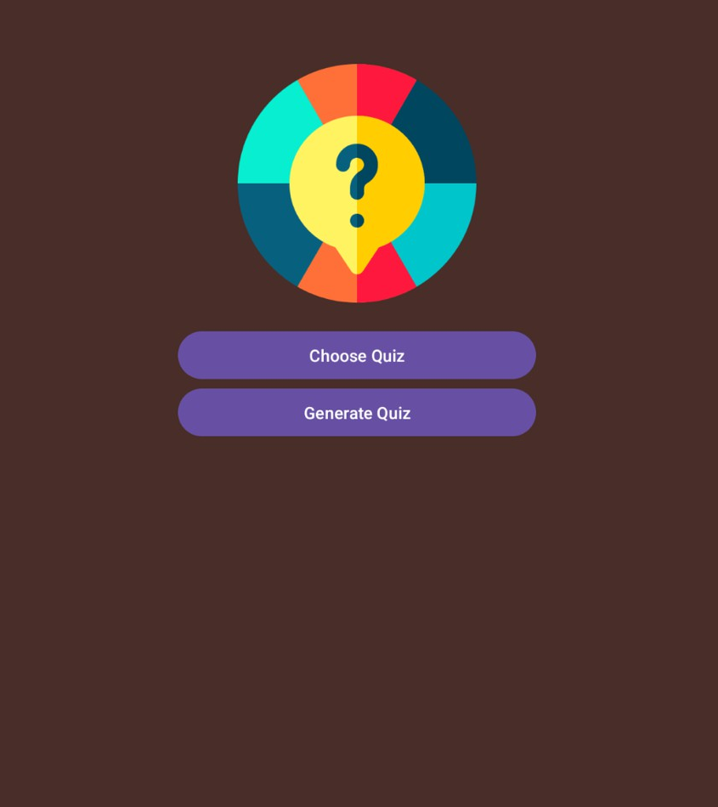
apP features:
The app opens with this page where the user has to select between the two options “Choose quiz” and “Generate Quiz”.

Slide 3

apP features:
If the user clicks on the “Choose Quiz” button they will be redirected to this page. In this page the user has many quizzes to choose from and take a quiz.

Slide 4
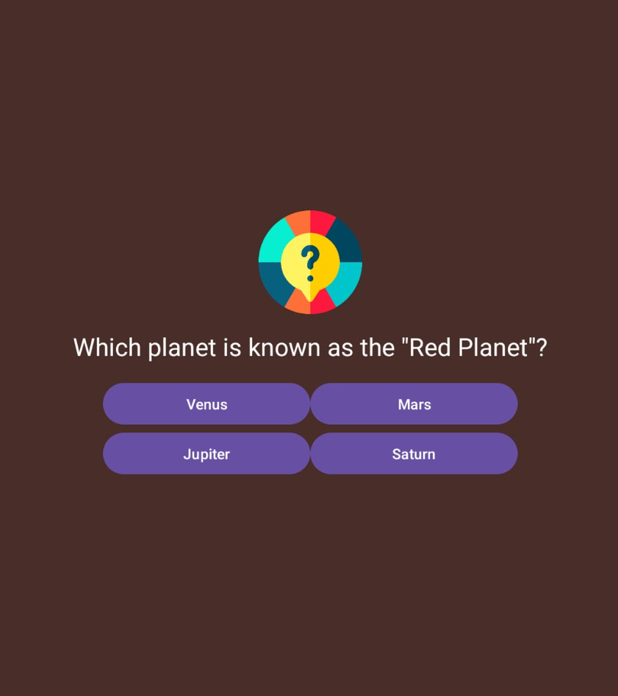
App features:
Here is the quiz UI of the app, where the user has a question to answer with 4 options to choose.

Slide 5
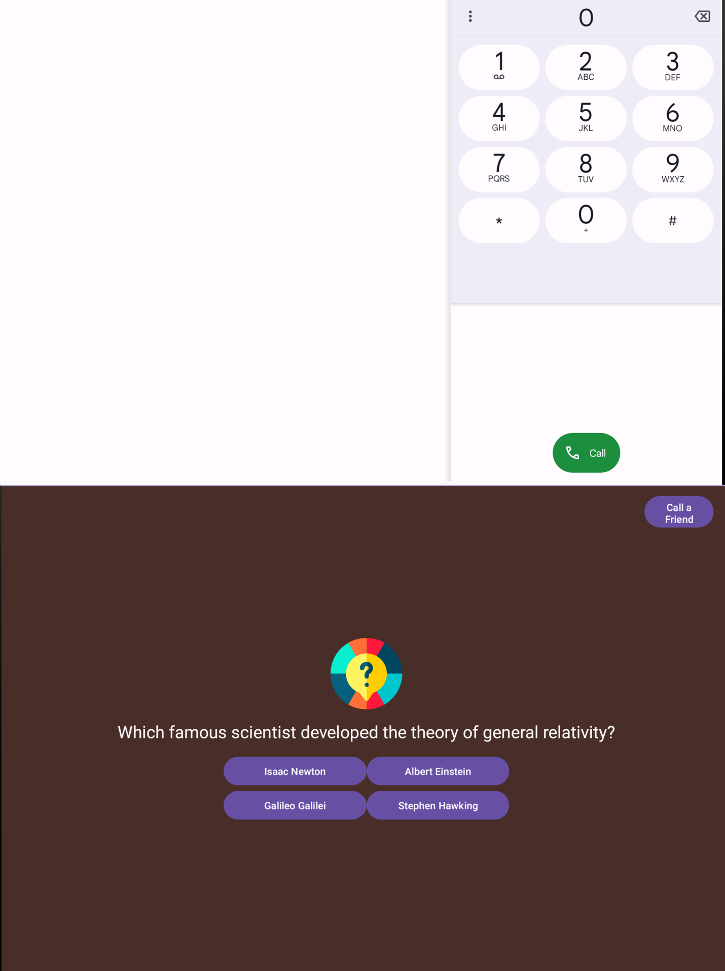
App features:
The App has a feature called “Call a Friend” which redirects the user to the phone app when the button is clicked.

Slide 6

App features:
After answering all the questions, the user will be directed to this end page where the user gets their score with an applause video and audio playing in the background.
The user can save their score in a screenshot by clicking on the “Save ScoreScreen” button.

Slide 7
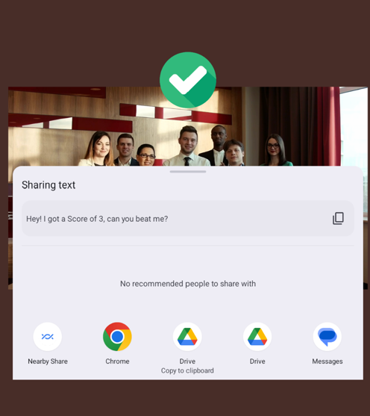
App features:
The user can share their quiz score through any social media app on their phone by just clicking on the “Share Results” button on the screen.

